Slide 1
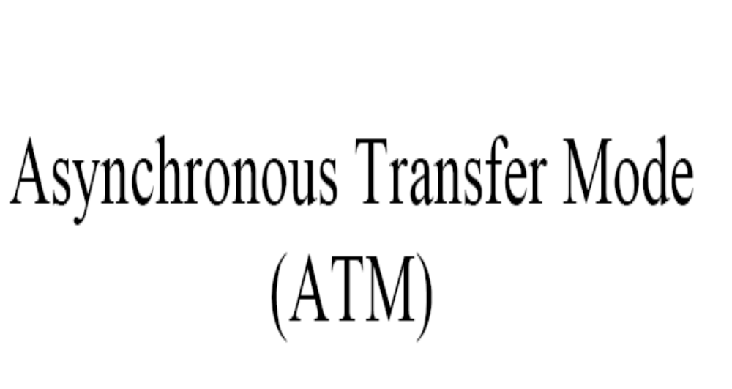

Slide 2
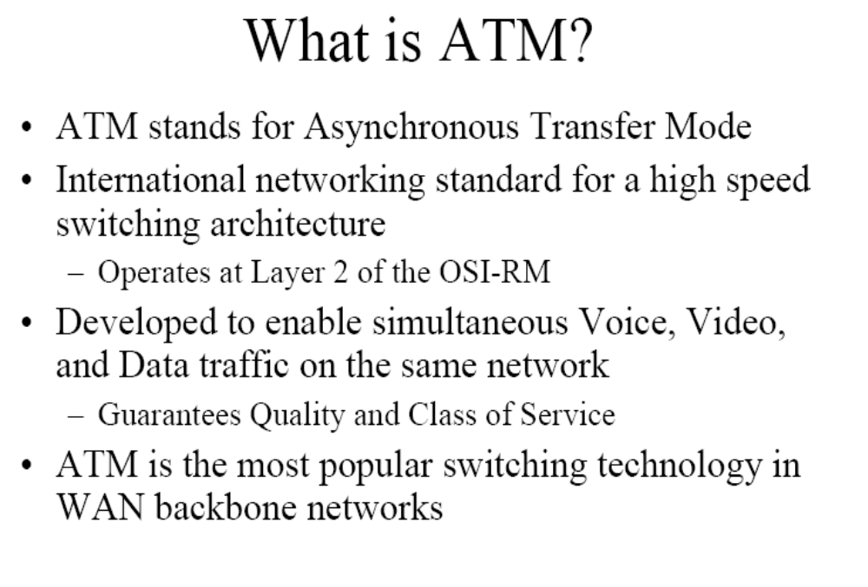

Slide 3
Need for ATM
Limitation of the existing technologies:
  Different protocols uses different frame sizes.
  For complex networks, information carried in the header is extensive leading to inefficiency.
  To reduce inefficiency, the size of the data field is increased or it is made variable.
  Variety of frame sizes makes traffic unpredictable and inconsistent data rate delivery.
  TDM is commonly used to make use of the broadband technology.
ATM technology has been developed to overcome these limitations.

Slide 4
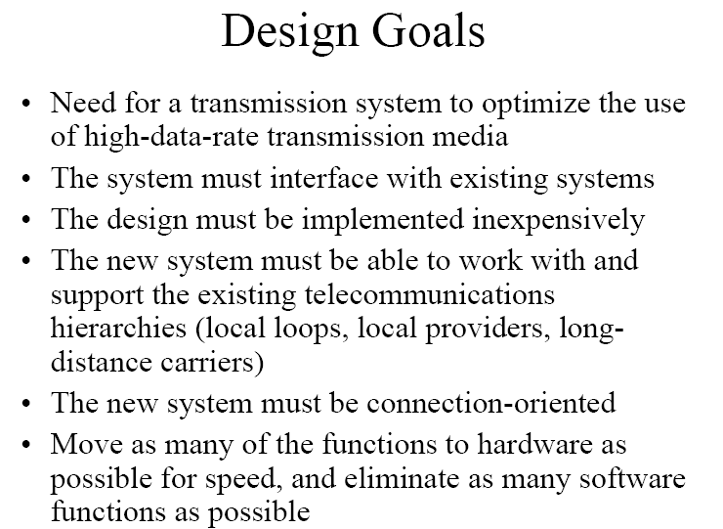

Slide 5
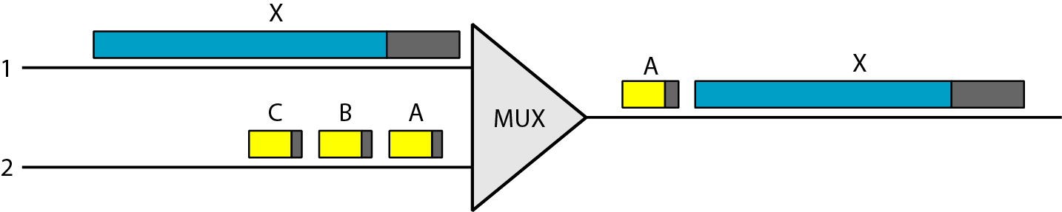
Multiplexing with variable size frames
Different frame sizes make traffic unpredictable.
Data rate delivery can vary dramatically.
Audio and video frames are usually small.

Slide 6
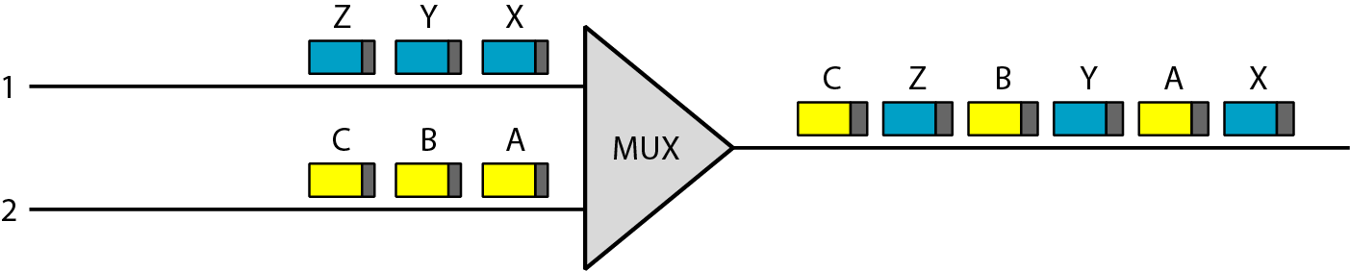
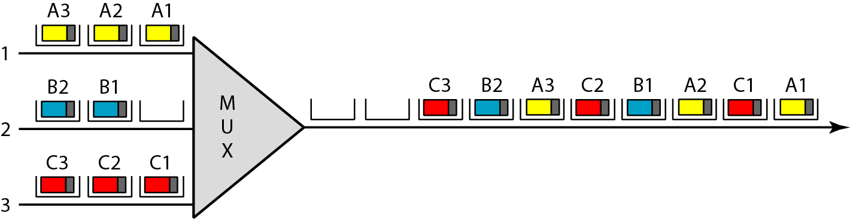
Cell Switching
Cell is considered as a fixed-sized block of information. (ATM-Cells 53 bytes)
Cell is used as the basic unit of data exchange.
ATM uses asynchronous TDM

Slide 7
Advantages of cells
In spite of interleaving,none suffers long delay.
Cells reach different destinations in the form of a continuous stream because of high speed and the small size of cells.
Switching and multiplexing by hardware at the cell level makes implementation inexpensive and faster

Slide 8
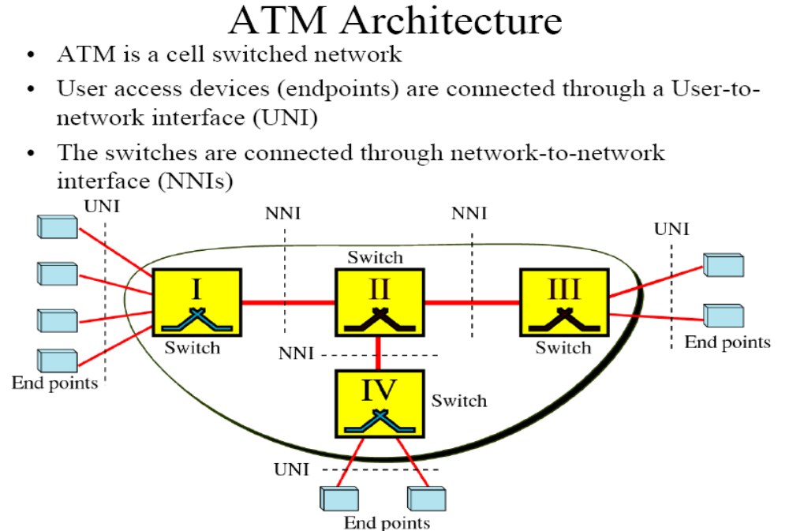

Slide 9
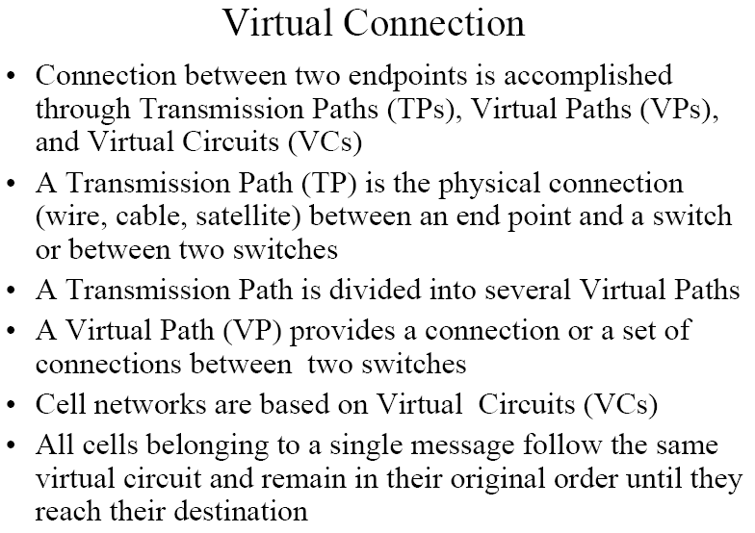

Slide 10
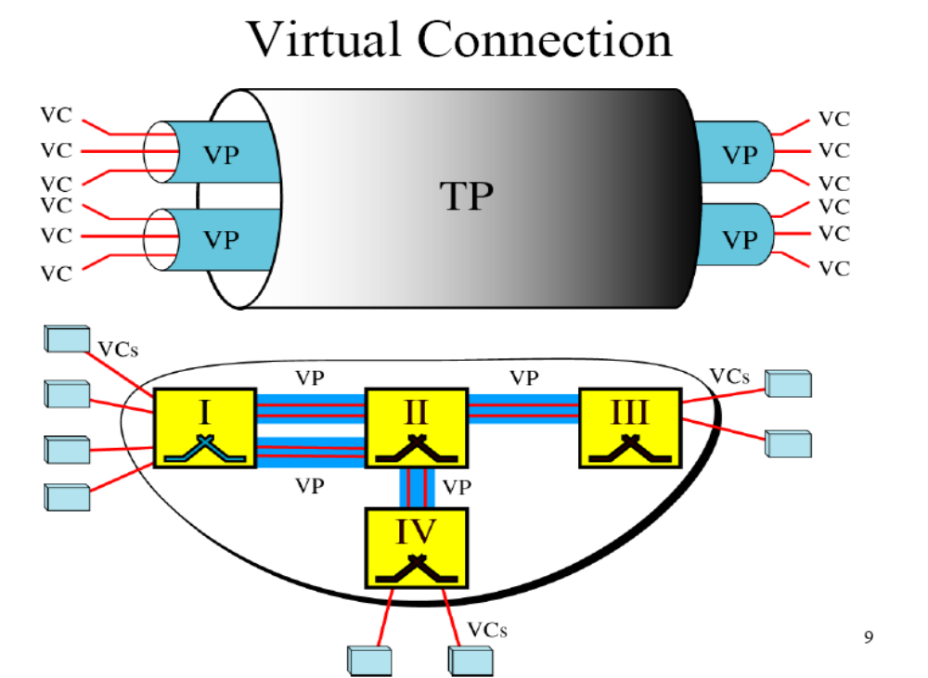

Slide 11
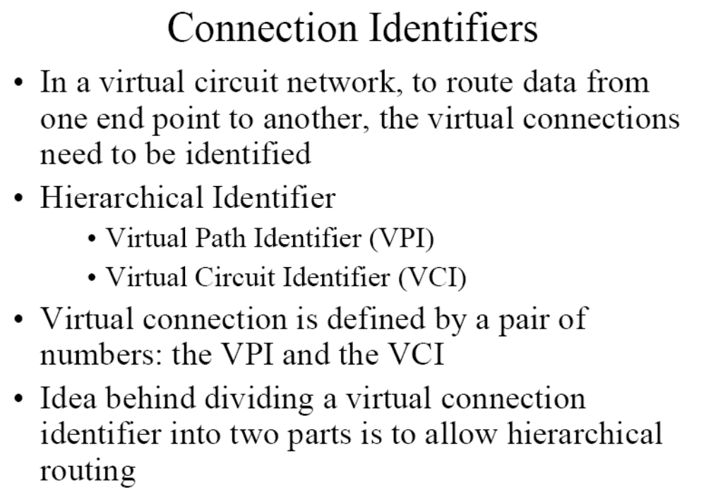

Slide 12
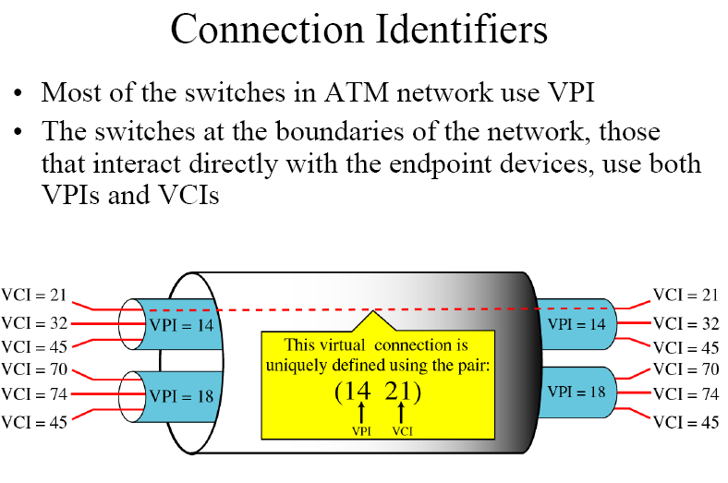

Slide 13
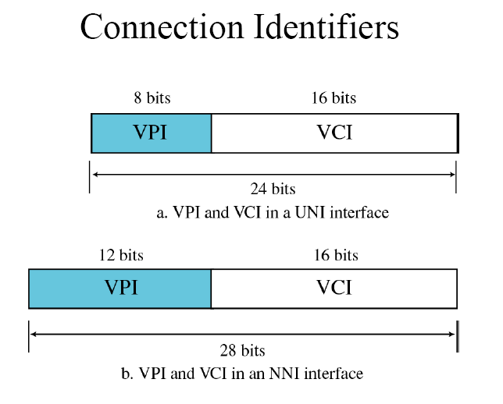

Slide 14
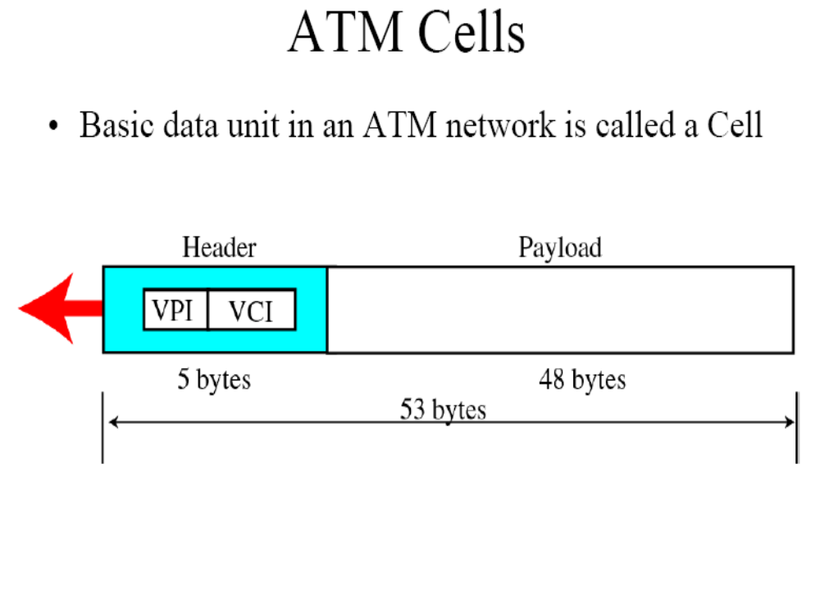

Slide 15
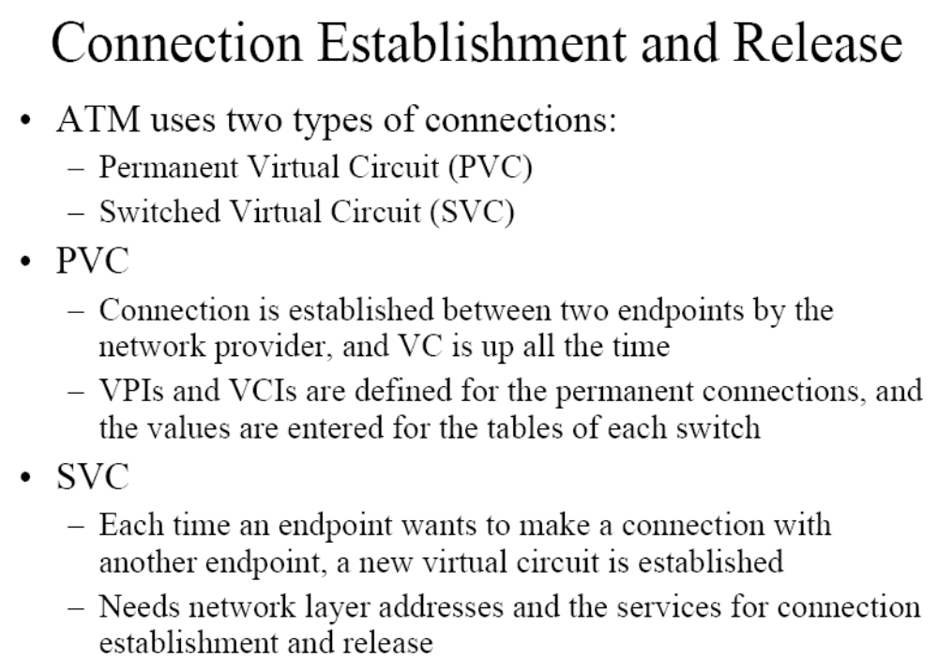

Slide 16
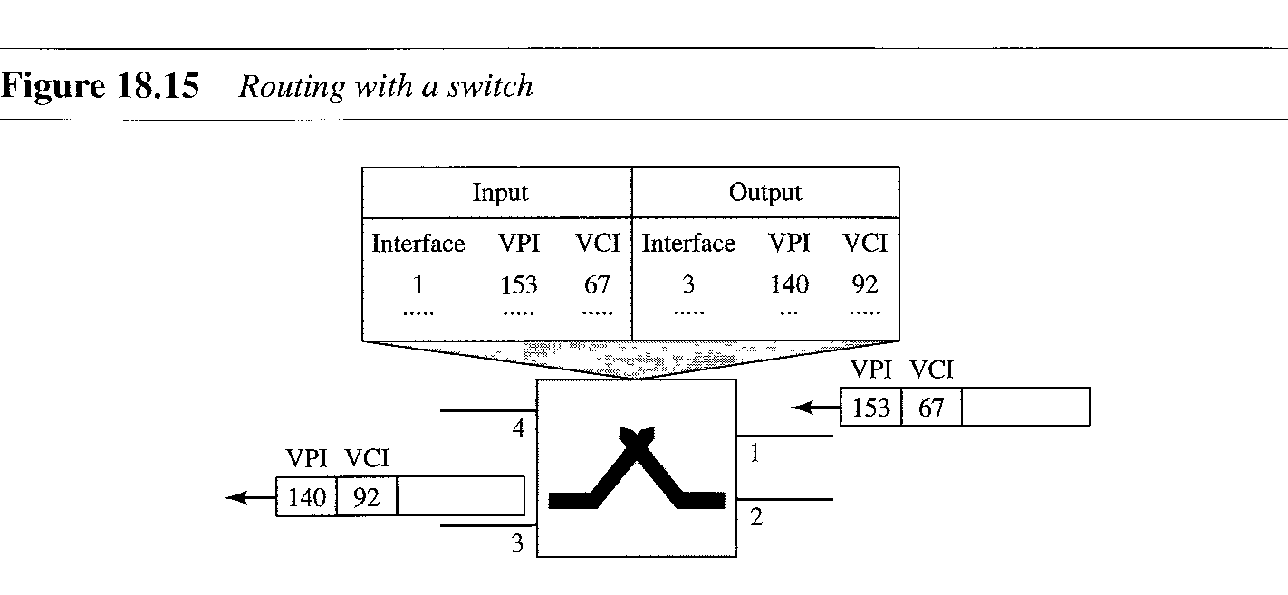
Switching

Slide 17
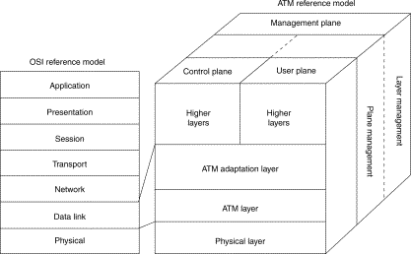
ATM TECHNOLOGY REFERENCE MODEL

Slide 18
Protocol Architecture
Similarities between ATM and packet switching
  Transfer of data in discrete chunks
  Multiple logical connections over single physical interface
In ATM flow on each logical connection is in fixed sized packets called cells
Minimal error and flow control
  Reduced overhead
Data rates (physical layer) 25.6Mbps to 622.08Mbps

Slide 19
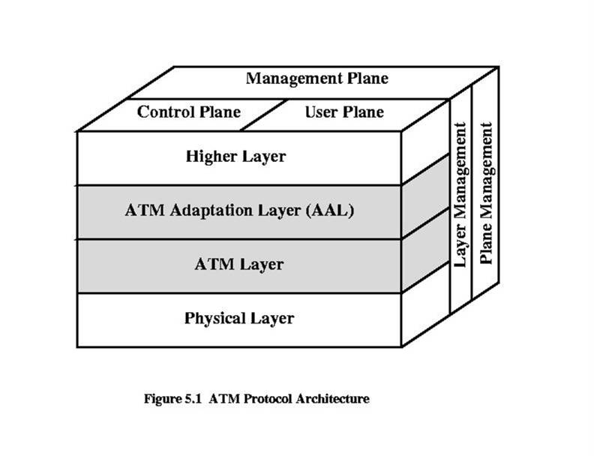
ATM Protocol Reference Model
Map data to the ATM cell
structure
Framing, cell structure
& Logical Connections
Various data rates (155.52 Mbps, 622.08 Mbps) over various physical media types (Fiber Optic, SONET, UTP, etc.)

Slide 20
Reference Model has 3 planes
User – provides for user information transfer and associated controls (flow control, congestion control)
Control – performs call control and connection control functions (signaling)
Management – provides plane management - performs management functions related to a system as a whole and provides coordination between all the planes and layer management – performs management functions relating to resources and parameters residing in its protocol entities.

Slide 21
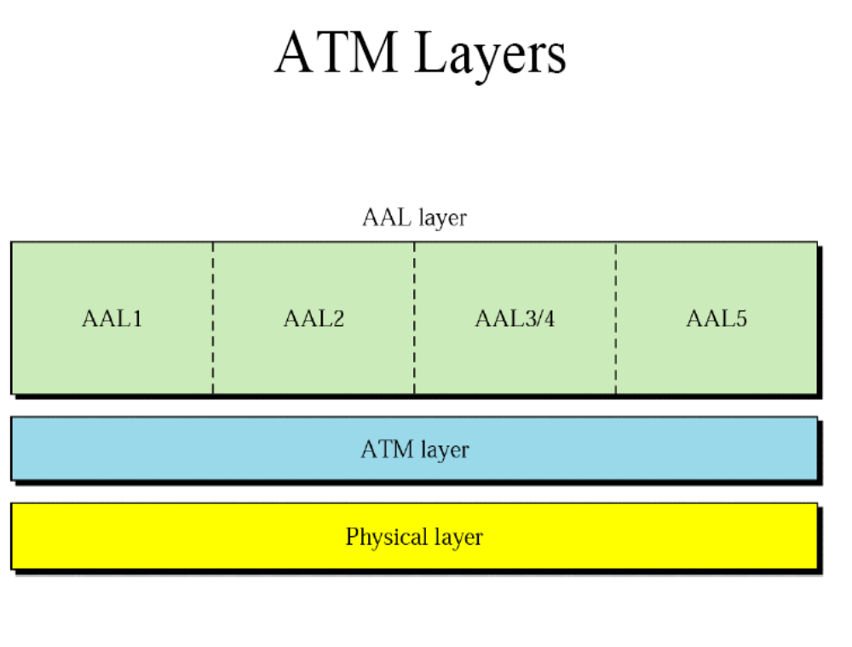

Slide 22
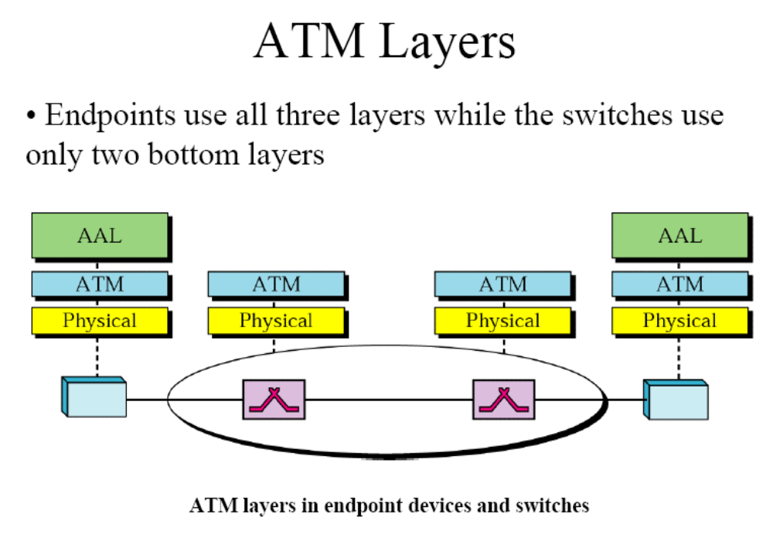

Slide 23
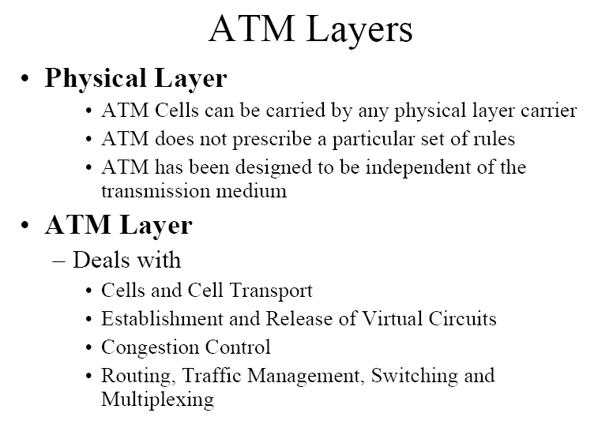

Slide 24
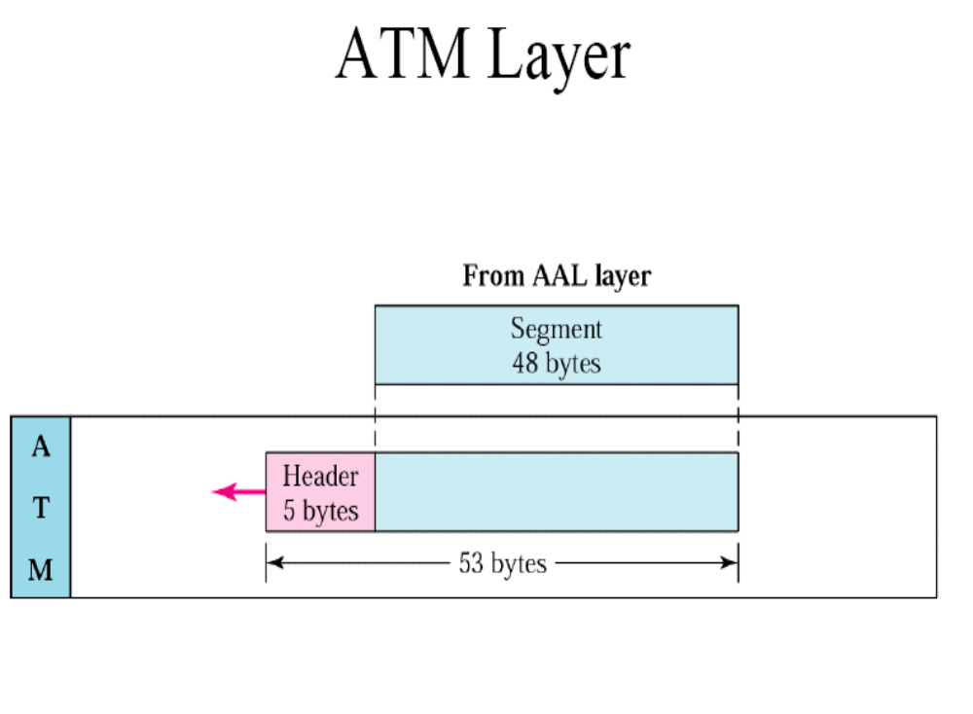

Slide 25
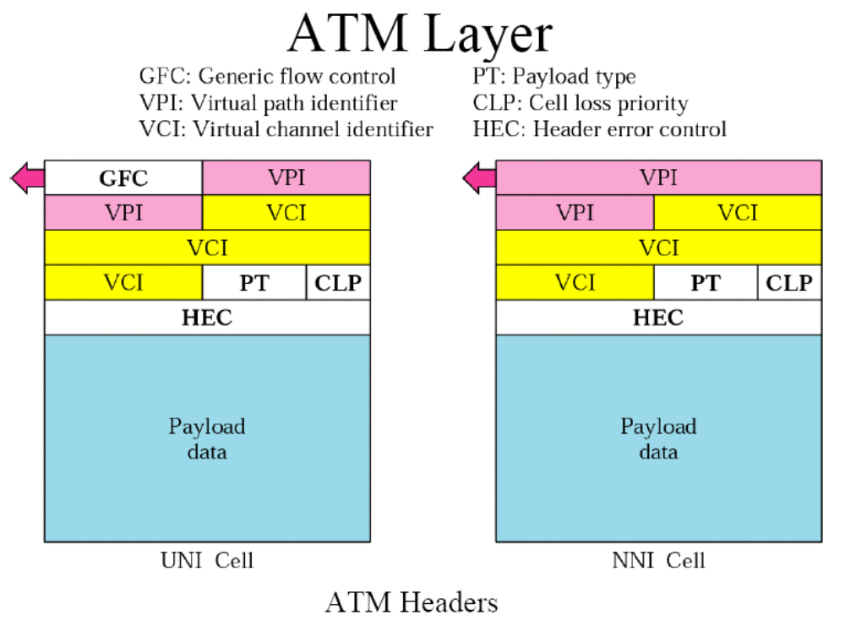

Slide 26
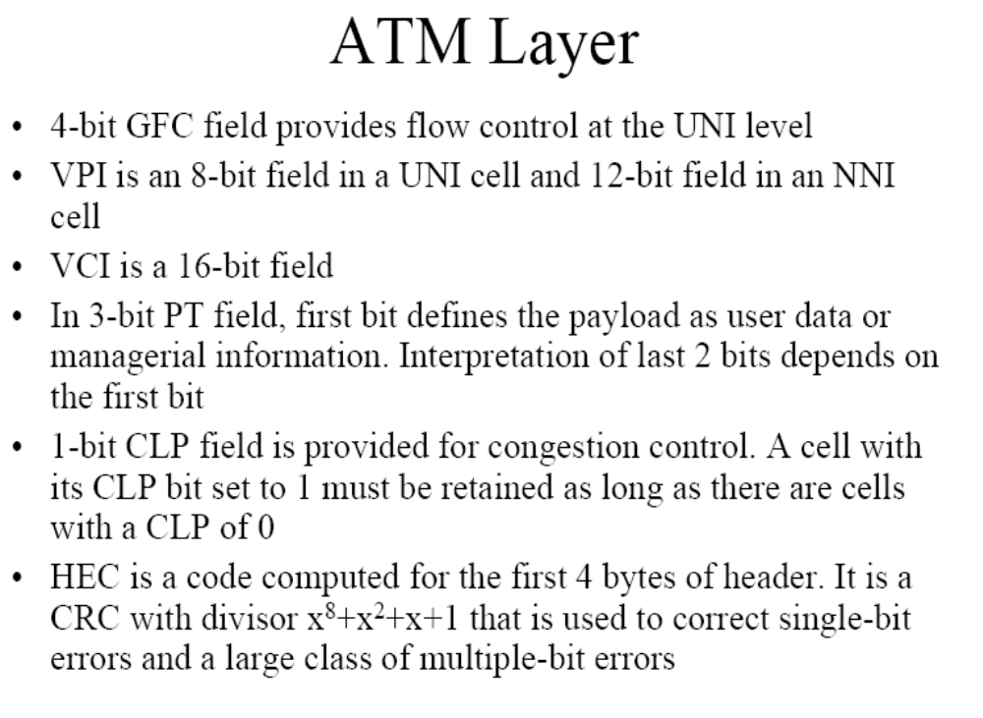

Slide 27
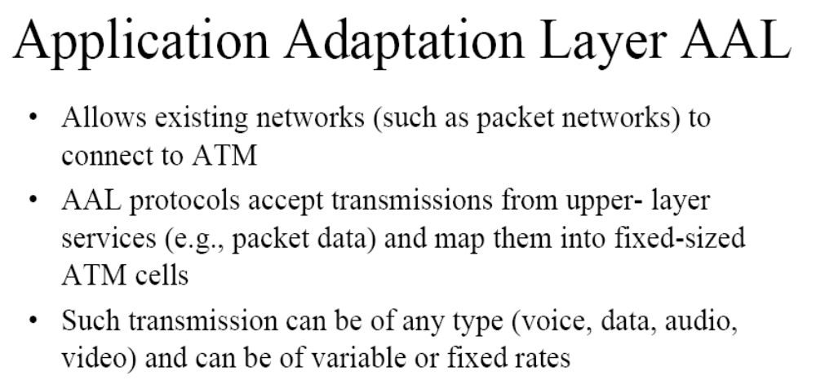
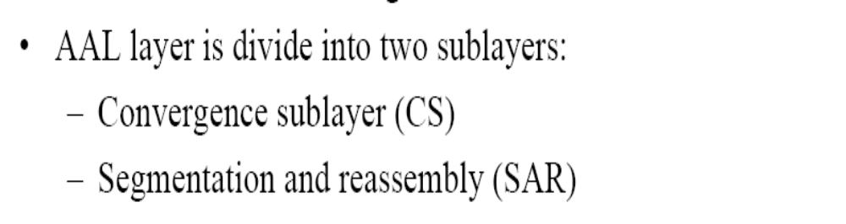

Slide 28
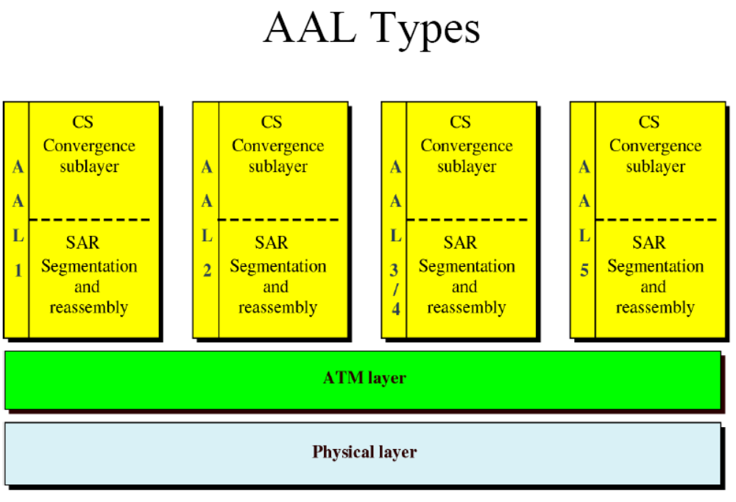

Slide 29
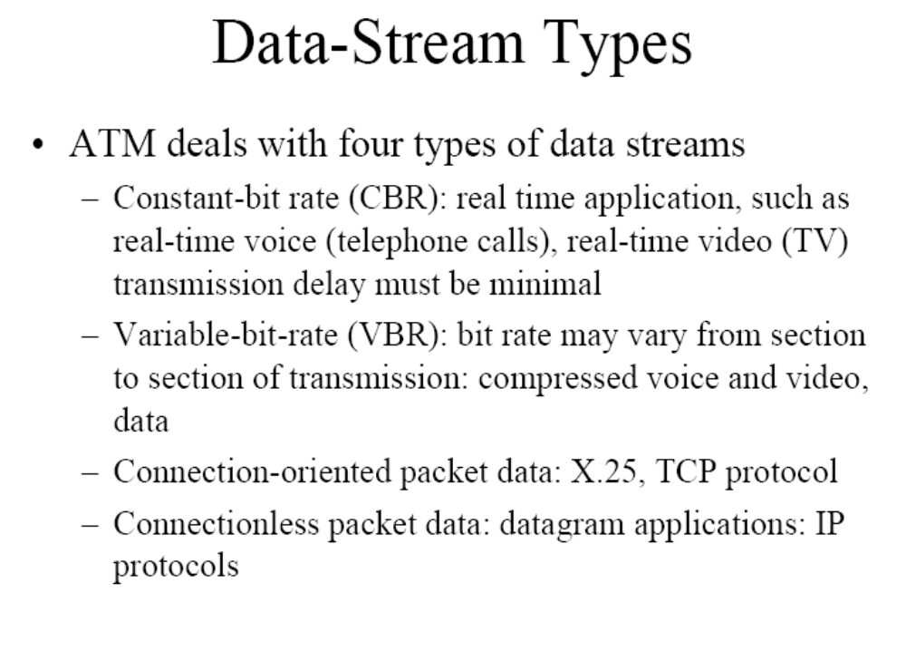

Slide 30
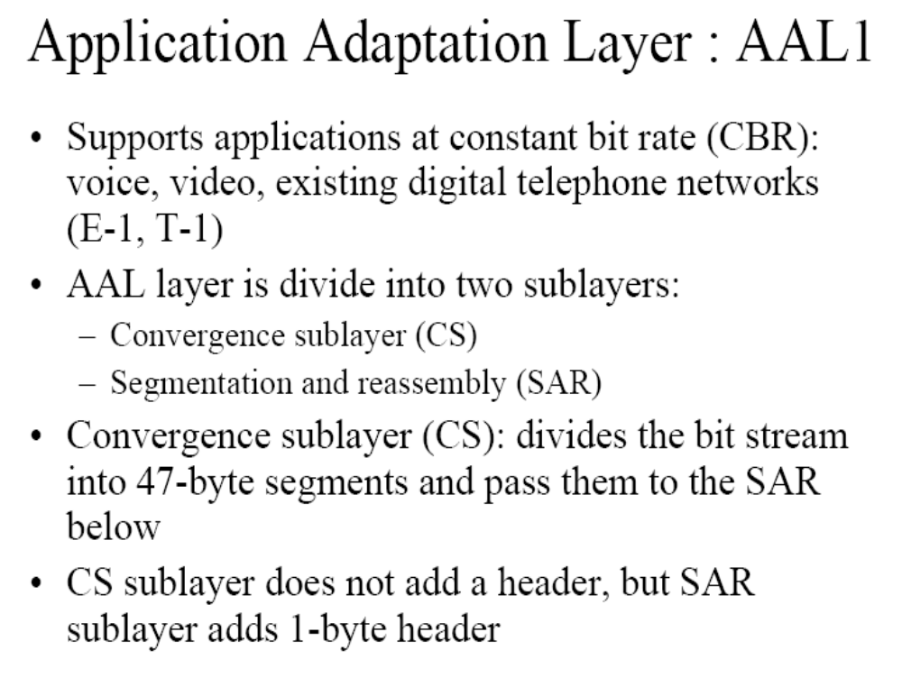

Slide 31
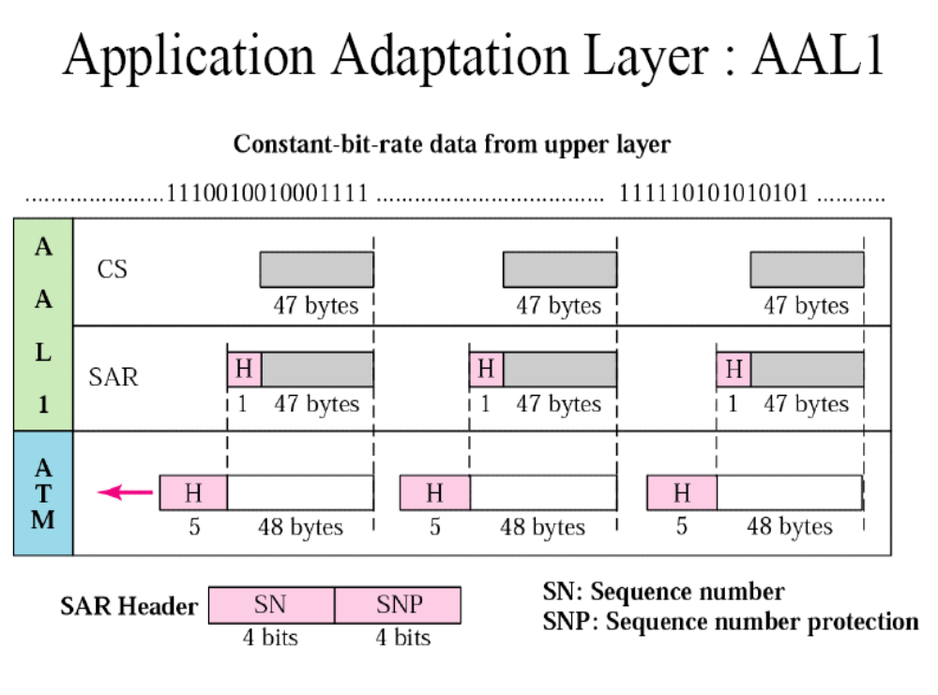

Slide 32
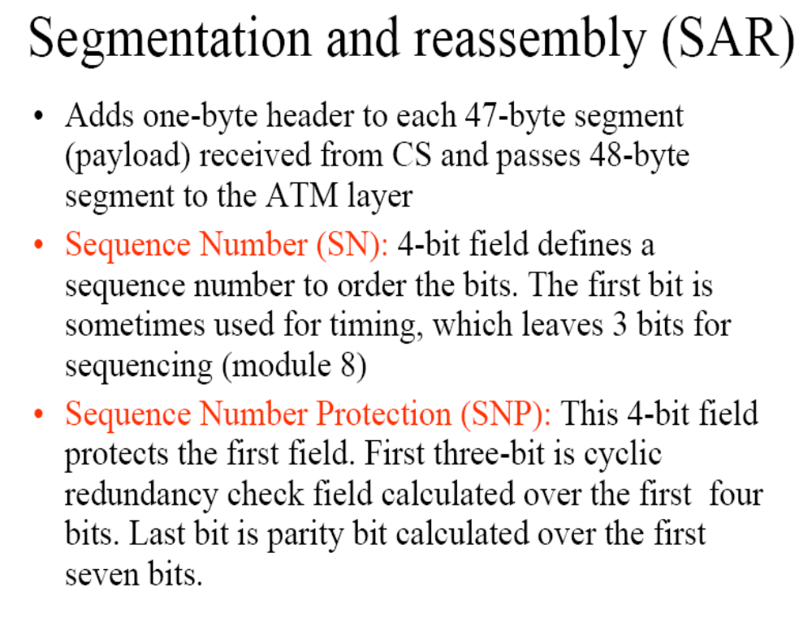

Slide 33
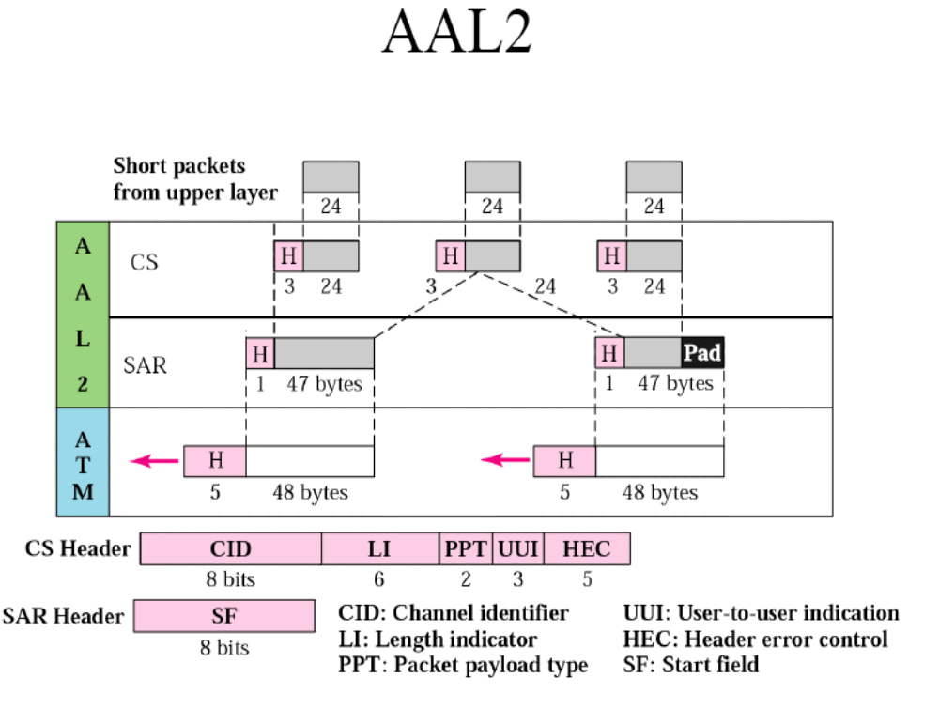

Slide 34
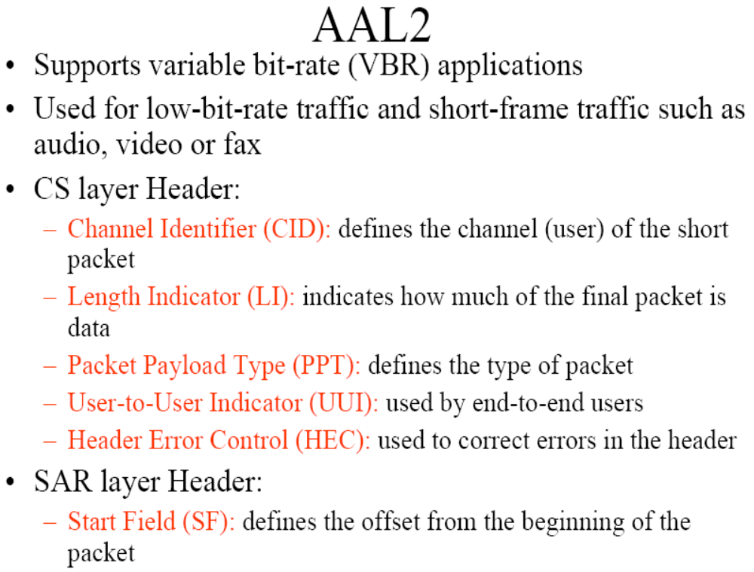

Slide 35
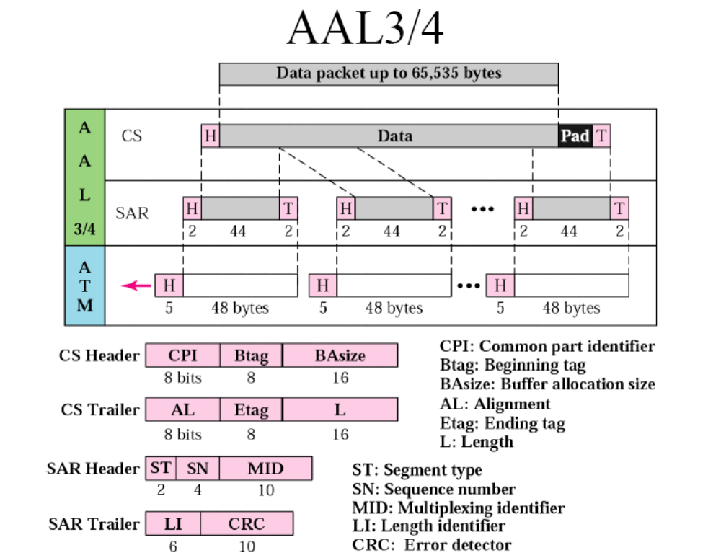

Slide 36
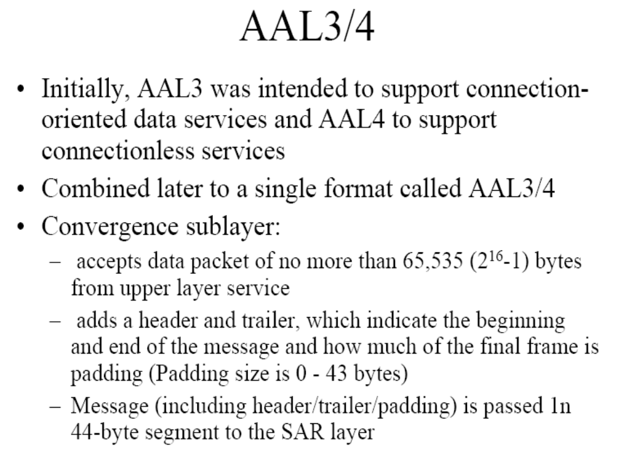

Slide 37
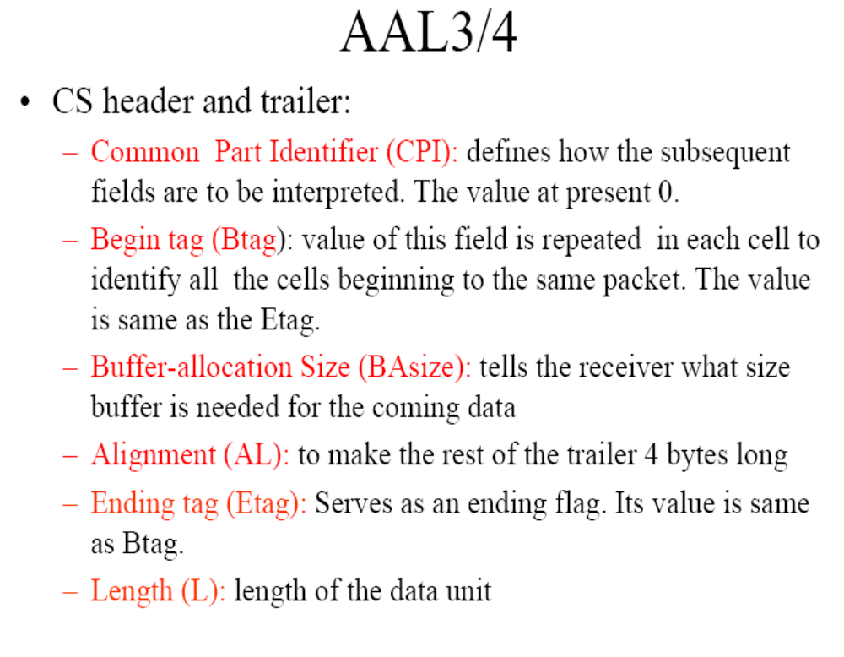

Slide 38
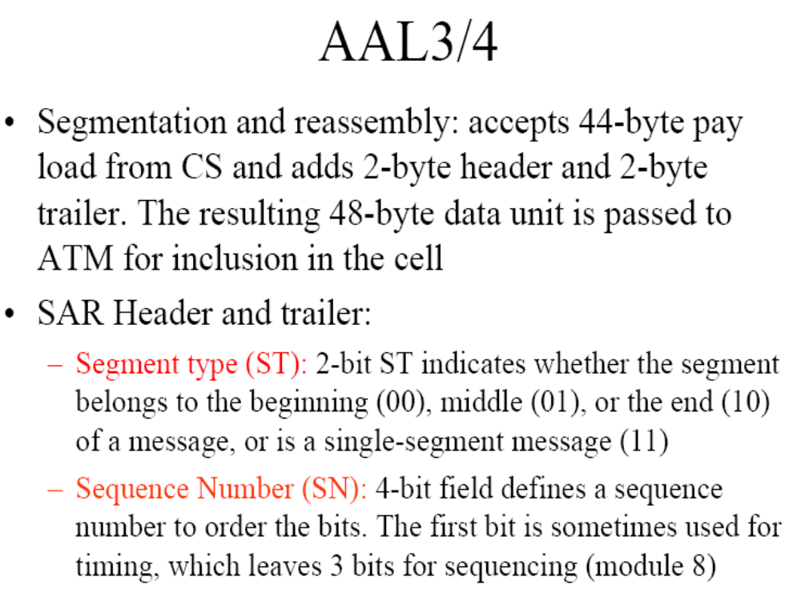

Slide 39
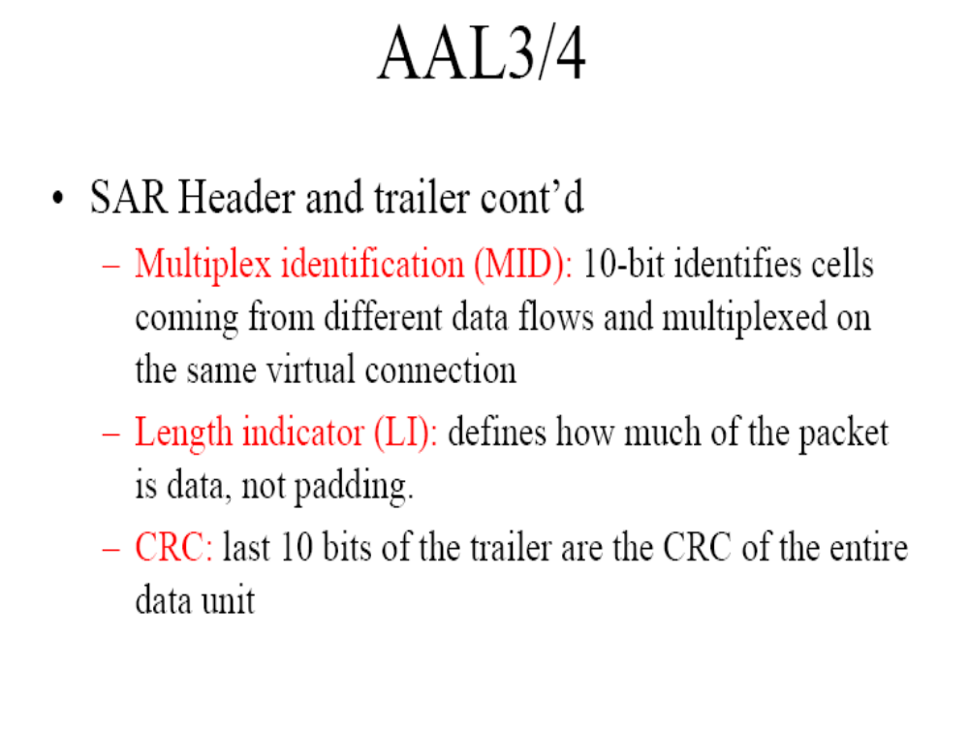

Slide 40
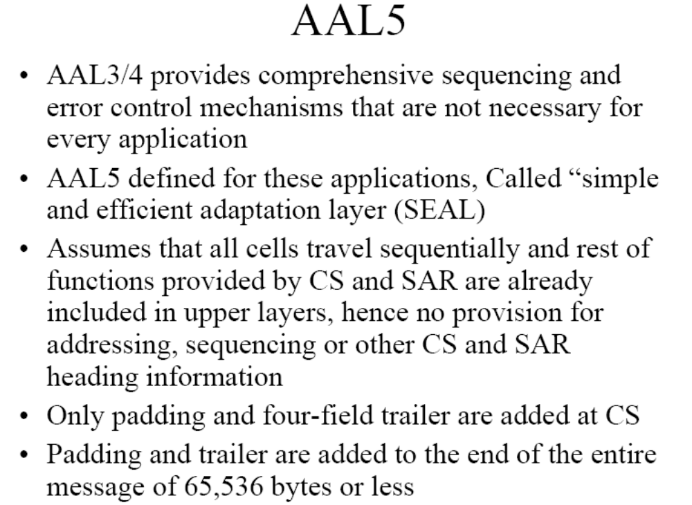

Slide 41
